Slide 1

IOT Based iv bag Monitoring system
TEAM MEMBERS :
JAINAM SHAH
ASHISH KHADELA
SHIV GANDHI
KASHISH RAO
YASH MANDALIYA
HELI MEHTA
TEAM OBSALINE

Slide 2

PROBLEMS
AIR
EMBOLISM
REVERSE OSMOSIS

Slide 3

EXISTING SOLUTION
Human Monitoring
Nurses
Family Member

Slide 4
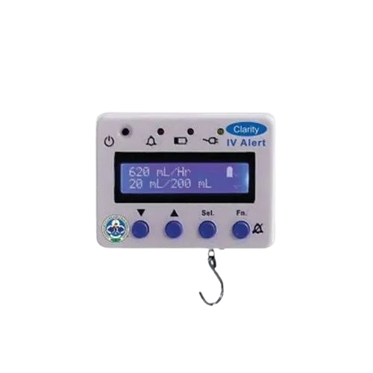
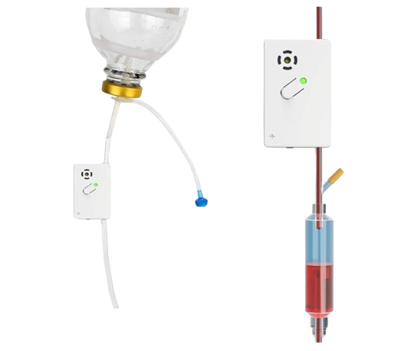
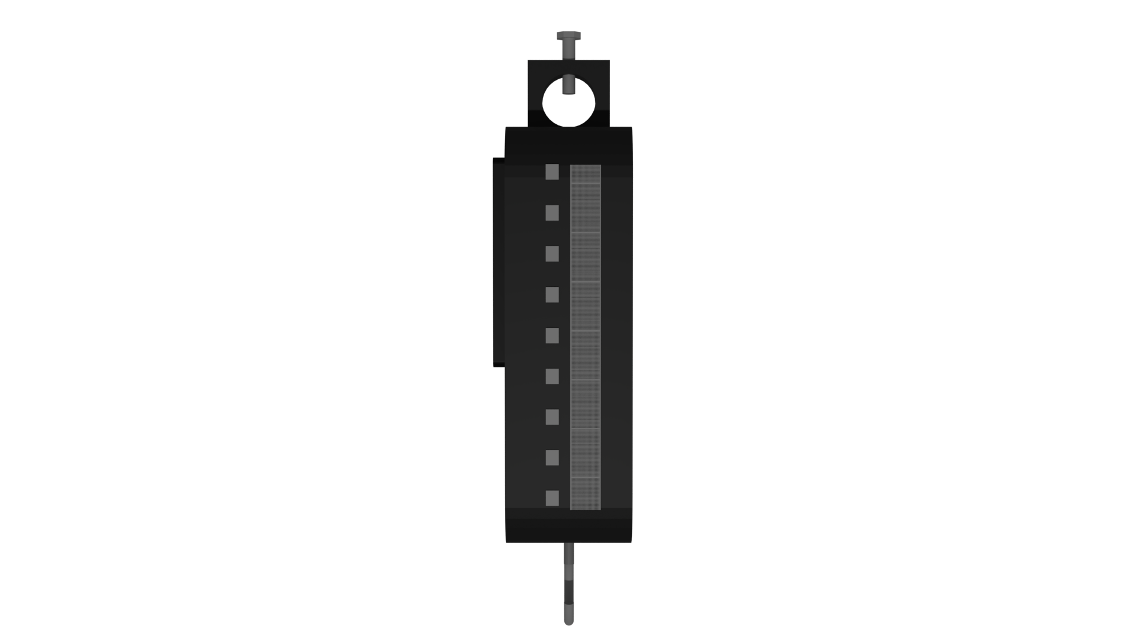

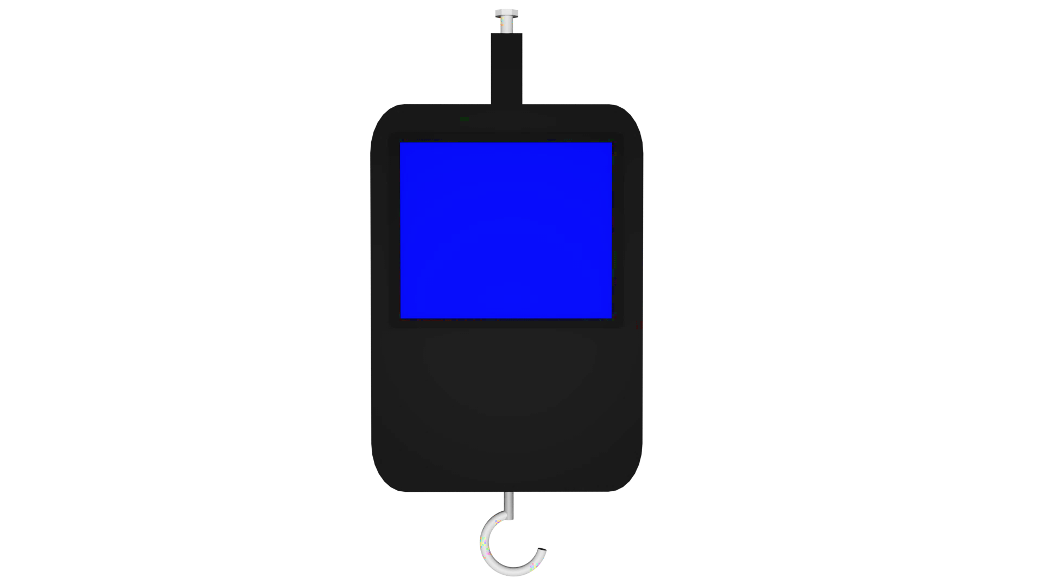
IV GAURDIAN

Slide 5
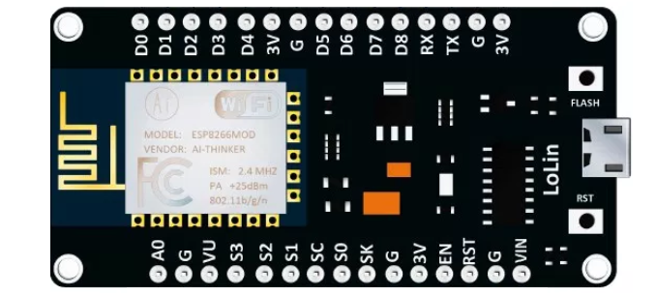
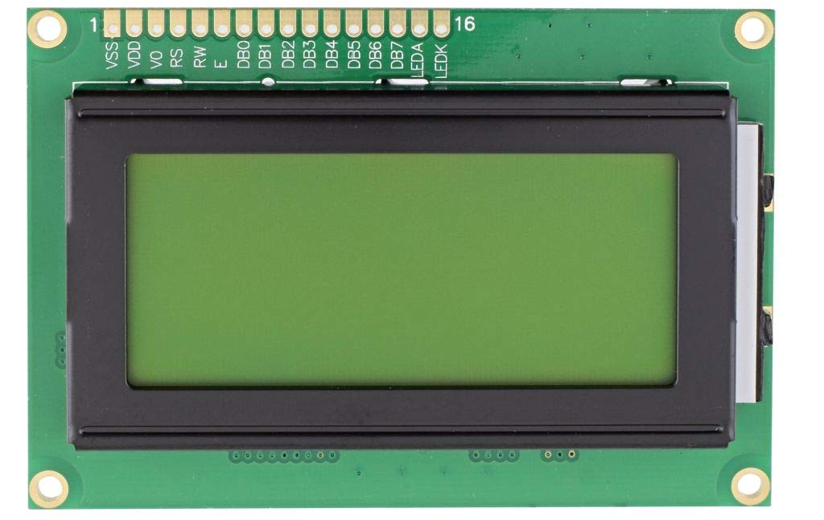
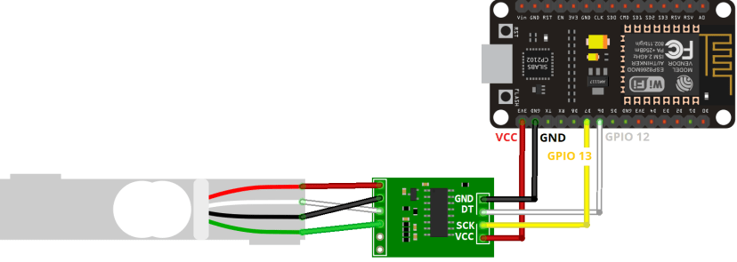
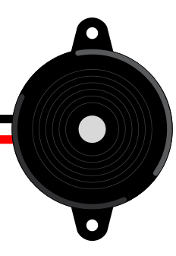

Components

Slide 6
Market analysis
Frequent Use of IV Bag
No Automatic Device Available
Issue of Iv bag draining out

Slide 7
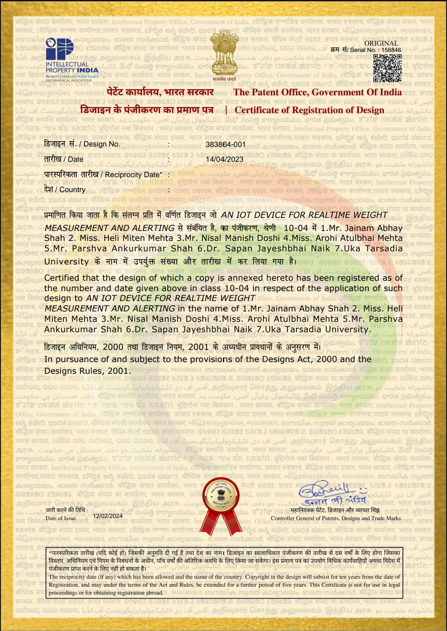
DESIGN PATENT
OBSALINE TECH

Slide 8
THANK YOU

